Slide 1
22
International Corporate Finance

Slide 2

Chapter 22 – Index of Sample Problems
Slide # 02 - 03 Currency conversion
Slide # 04 - 05 Premium/discount
Slide # 06 - 07 Cross-rate
Slide # 08 - 09 Triangle arbitrage
Slide # 10 - 11 Currency appreciation/depreciation
Slide # 12 - 13 Absolute purchasing power parity
Slide # 14 - 17 Relative purchasing power parity
Slide # 18 - 21 Interest rate parity
Slide # 22 - 23 Uncovered interest parity
Slide # 24 - 25 International Fisher effect
Slide # 26 - 27 Foreign currency approach

Slide 3
2: Currency conversion
How many Turkish lira can you get for $1,500?
How many U.S. dollars can you get for 1,500 Russian rubles?
Country | U.S. $ Equivalent | Currency Per U.S. $
Poland | .26860 | 3.7230
Russia | .03445 | 29.028
Turkey | .00000067 | 1492537
U.K. | 1.8301 | .5464
U.K. 3 mo | 1.8153 | .5509
U.K. 6 mo | 1.8022 | .5549

Slide 4
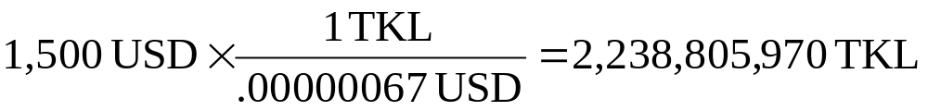
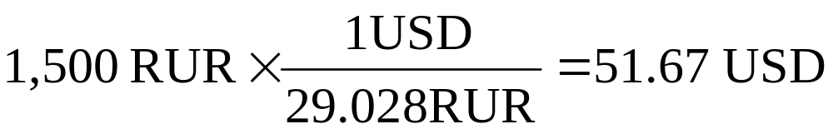
3: Currency conversion

Slide 5
4: Premium/discount
Is the British pound selling at a premium or at a discount?
Country | U.S. $ Equivalent | Currency Per U.S. $
Poland | .26860 | 3.7230
Russia | .03445 | 29.028
Turkey | .00000067 | 1492537
U.K. | 1.8301 | .5464
U.K. 3 mo | 1.8153 | .5509
U.K. 6 mo | 1.8022 | .5549

Slide 6
5: Premium/discount
Today:
£1 = $1.8301
3 months:
£1 = $1.8153
6 months:
£1 = $1.8022
Because the pound is selling for less in the future, it is selling at a discount relative to the dollar.
Country | U.S. $ Equivalent | Currency Per U.S. $
Poland | .26860 | 3.7230
Russia | .03445 | 29.028
Turkey | .00000067 | 1492537
U.K. | 1.8301 | .5464
U.K. 3 mo | 1.8153 | .5509
U.K. 6 mo | 1.8022 | .5549

Slide 7
6: Cross-rate
What is the cross-rate between the Polish zloty and the Russian ruble?
Country | U.S. $ Equivalent | Currency Per U.S. $
Poland | .26860 | 3.7230
Russia | .03445 | 29.028
Turkey | .00000067 | 1492537
U.K. | 1.8301 | .5464
U.K. 3 mo | 1.8153 | .5509
U.K. 6 mo | 1.8022 | .5549

Slide 8
7: Cross-rate
1 USD = 3.723 PLN
1 USD = 29.028 RUR
3.723 PLN = 29.028 RUR
1 PLN = 7.797 RUR
Country | U.S. $ Equivalent | Currency Per U.S. $
Poland | .26860 | 3.7230
Russia | .03445 | 29.028
Turkey | .00000067 | 1492537
U.K. | 1.8301 | .5464
U.K. 3 mo | 1.8153 | .5509
U.K. 6 mo | 1.8022 | .5549

Slide 9
8: Triangle arbitrage
Assume that you can buy 29.028 Russian rubles for .53 British pounds.
Can you profit from triangle arbitrage?
If so, how?
Country | U.S. $ Equivalent | Currency Per U.S. $
Poland | .26860 | 3.7230
Russia | .03445 | 29.028
Turkey | .00000067 | 1492537
U.K. | 1.8301 | .5464
U.K. 3 mo | 1.8153 | .5509
U.K. 6 mo | 1.8022 | .5549

Slide 10
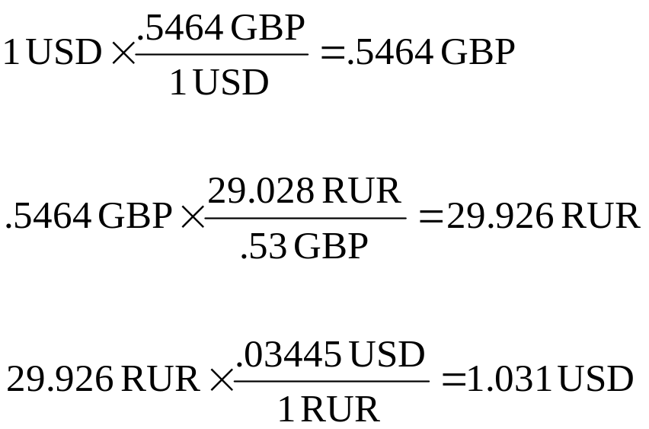
9: Triangle arbitrage
Country | U.S. $ Equivalent | Currency Per U.S. $
Russia | .03445 | 29.028
U.K. | 1.8301 | .5464
29.028 RUR = .53 GBP

Slide 11
10: Currency appreciation/depreciation
Assume that tomorrow the U.S.$ equivalent of the British pound is 1.8306.
Will the U.S. dollar have appreciated or depreciated relative to the British pound?
Country | U.S. $ Equivalent | Currency Per U.S. $
Poland | .26860 | 3.7230
Russia | .03445 | 29.028
Turkey | .00000067 | 1492537
U.K. | 1.8301 | .5464
U.K. 3 mo | 1.8153 | .5509
U.K. 6 mo | 1.8022 | .5549

Slide 12
11: Currency appreciation/depreciation
Today:
£1 = $1.8301
Tomorrow:
£1 = 1.8306
The U.S. dollar has depreciated relative to the British pound because it will take more dollars tomorrow to purchase one British pound.
Country | U.S. $ Equivalent | Currency Per U.S. $
Poland | .26860 | 3.7230
Russia | .03445 | 29.028
Turkey | .00000067 | 1492537
U.K. | 1.8301 | .5464
U.K. 3 mo | 1.8153 | .5509
U.K. 6 mo | 1.8022 | .5549

Slide 13
12: Absolute purchasing power parity
You can buy your favorite shoes in the U.S. for $59 a pair.
If absolute purchasing power parity exists, what will those same shoes cost in Turkey?
Country | U.S. $ Equivalent | Currency Per U.S. $
Poland | .26860 | 3.7230
Russia | .03445 | 29.028
Turkey | .00000067 | 1492537
U.K. | 1.8301 | .5464
U.K. 3 mo | 1.8153 | .5509
U.K. 6 mo | 1.8022 | .5549

Slide 14
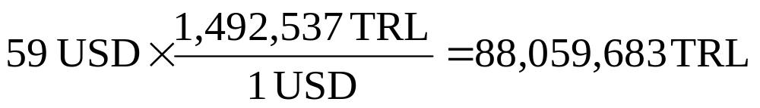
13: Absolute purchasing power parity
Country | U.S. $ Equivalent | Currency Per U.S. $
Turkey | .00000067 | 1492537

Slide 15
14: Relative purchasing power parity
The current spot rate between Canada and the U.S. is Can$1.35 per $1.00. The expected inflation rate in the U.S. is 3%. The expected inflation rate in Canada is 2%. Assume that relative purchasing power parity exists.
What is the expected exchange rate next year?

Slide 16
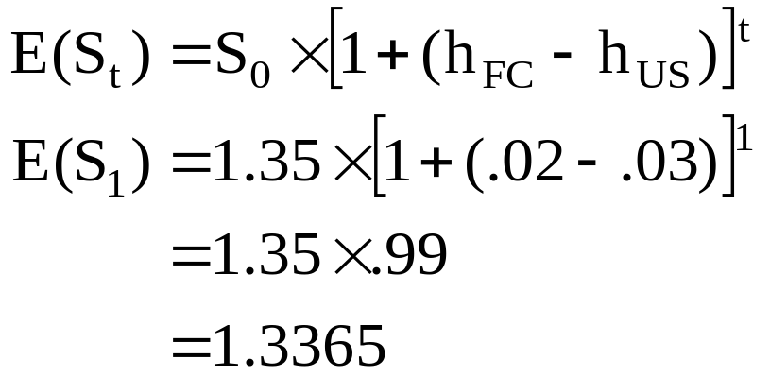
15: Relative purchasing power parity
U.S. Canada
Price today $100.00 $135.00
Inflation × 1.03 × 1.02
Price next year $103.00 $137.70
Conversion: $137.70/$103.00 = 1.3369
Today:
$1 = Can$1.35
Next year:
$1 = Can$1.3365

Slide 17
16: Relative purchasing power parity
The current spot rate between Mexico and the U.S. is Ps11.48 per $1.00. The expected inflation rate in the U.S. is 3%. The expected inflation rate in Mexico is 6%. Assume that relative purchasing power parity exists.
What is the expected exchange rate in 2 years?

Slide 18
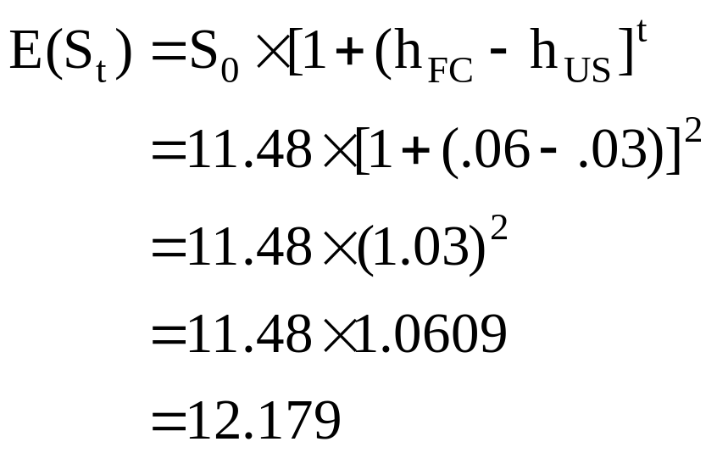
17: Relative purchasing power parity

Slide 19
18: Interest rate parity
The 1-year forward rate for the British pound is £.5479 per $1.00. The spot rate is £.5424 per $1.00. The rate on a risk-free British asset is 4%.
Approximately what rate can you earn by investing in a U.S. risk-free security for 1 year assuming that interest rate parity holds?

Slide 20
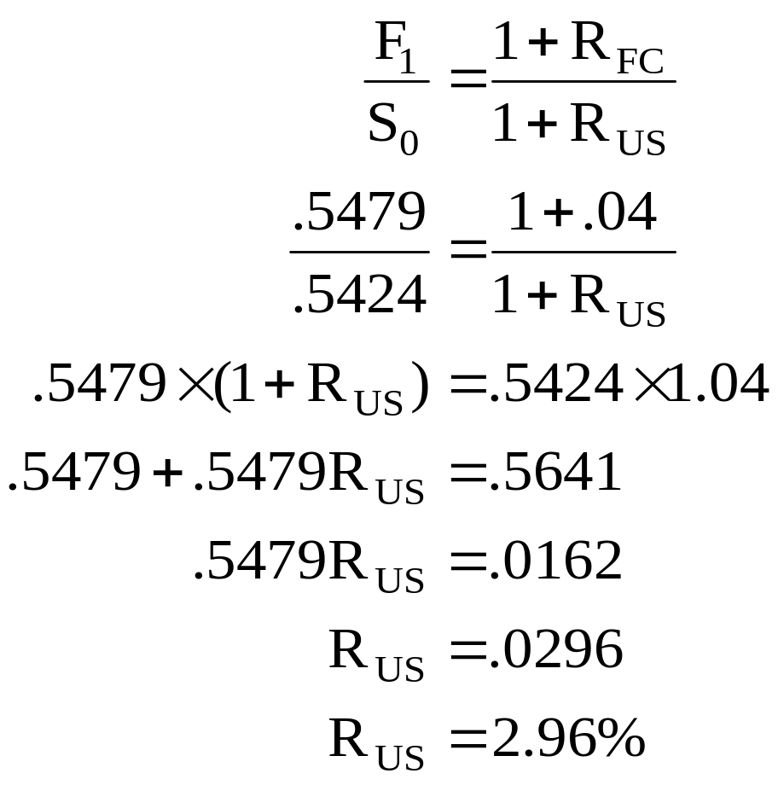
19: Interest rate parity

Slide 21
20: Interest rate parity
The current spot rate on the Japanese yen is ¥107.90 per $1.00. The rate on a risk-free Japanese asset is 6%. The rate on a U.S. Treasury bill is 3%.
What is the 3-year forward rate if interest rate parity holds?

Slide 22
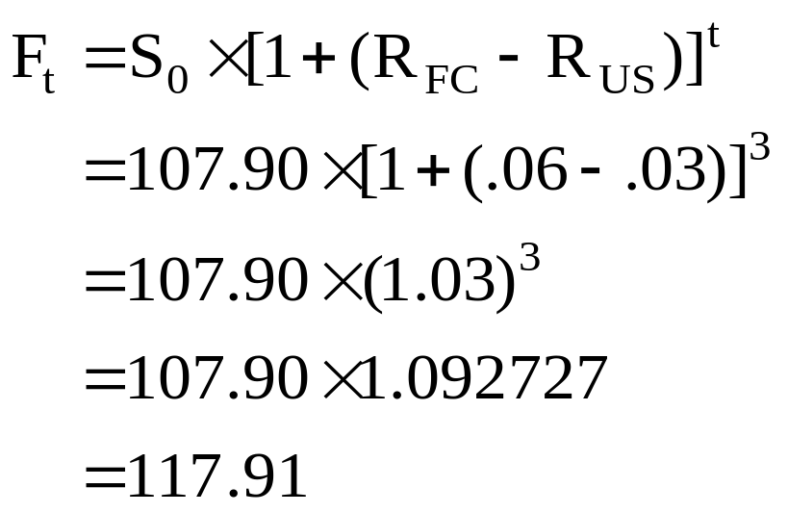
21: Interest rate parity

Slide 23
22: Uncovered interest parity
You are evaluating a prospective project in Norway. The project will cost NKr1.6 million and provide annual cash flows of NKr600,000 for 4 years. The current exchange rate is NKr6.84 per $1.00. The inflation rate in the U.S. is 3% and the U.S. Treasury bill is paying 4%. The risk-free rate in Norway is 6% and their inflation rate is 3.5%.
What is the cash flow in year 4 worth in terms of U.S. dollars?

Slide 24
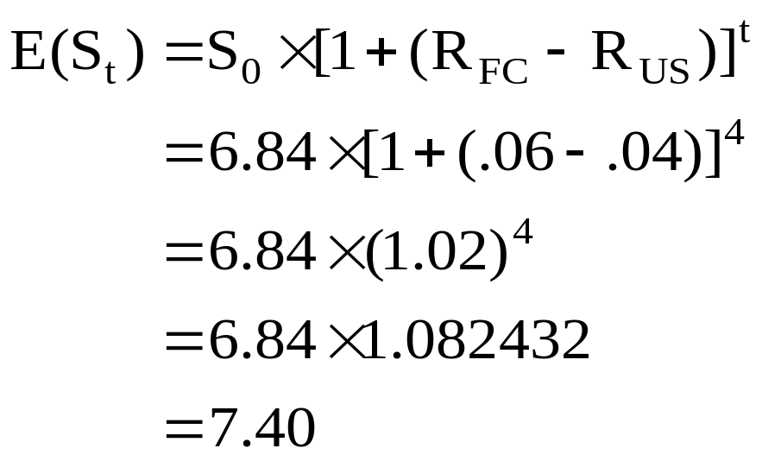
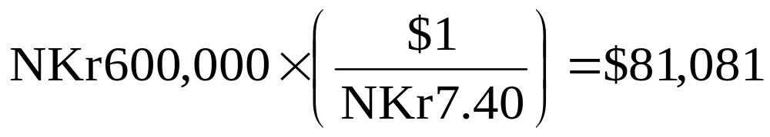
23: Uncovered interest parity

Slide 25
24: International Fisher effect
The U.S. Treasury bill is paying 5%. The expected inflation rate in the U.S. is 4%. The expected inflation rate in India is 13%.
The spot rate between the Indian rupee and the U.S. dollar is Rs45.851 per $1.00.
What rate of return should you expect to earn on a risk-free security in India?

Slide 26
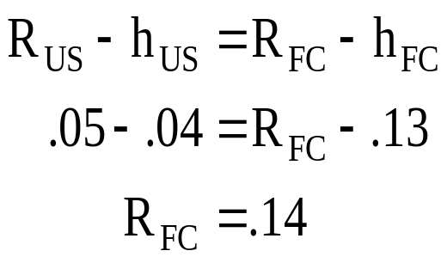
25: International Fisher effect
U.S. India
Risk-free rate 5% 14%
Inflation rate 4% 13%
Real rate 1% 1%

Slide 27
26: Foreign currency approach
You are considering opening a facility in Mexico. The facility will cost Ps3 million and produce cash inflows of Ps1.2 million a year for 3 years. After that the facility will be worthless. The U.S. Treasury bill is paying 6%. The expected inflation rate in the U.S. is 4%. The expected inflation rate in Mexico is 12%. The spot rate between the Mexican peso and the U.S. dollar is Ps11.63 per $1.00.
What is the net present value of this project in pesos using the foreign currency approach?
What is the net present value in dollars?

Slide 28
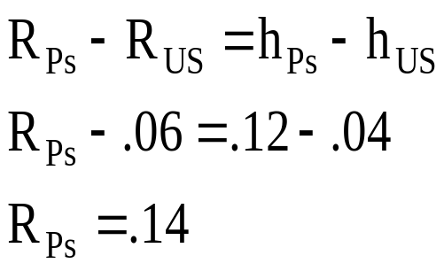
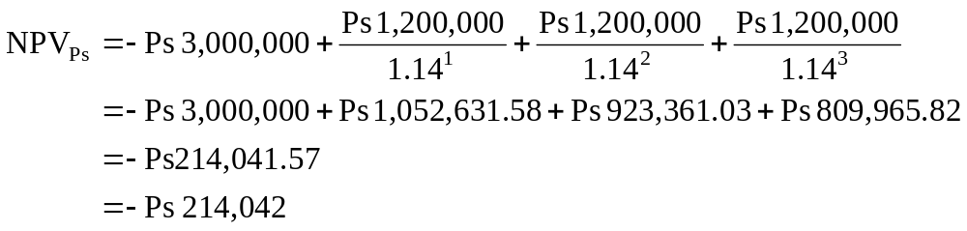
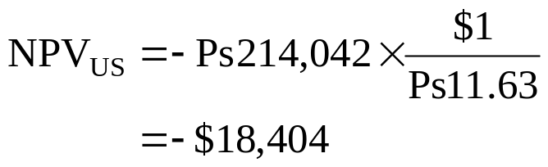
27: Foreign currency approach

Slide 29
22
End of Chapter 22

